Slide 1

Please keep your mobile phones on Silent Mode

Slide 2
Software:
Art?
Science?
Engineering?

Slide 3
Types of Applications Systems-1
MANAGEMENT
Transaction
Processing
Systems
Workflow
Systems
KNOWLEDGE
WORKERS
OPERATIONAL
STAFF
Notes:
The concept of workflow management systems deal with busines acitvities processes ,the workflow control,planning eg.life insurance policy claims,leave management systems etc.

Slide 4
Types of Applications Systems-2
Executive
Information
Systems
Strategic
Planning
/ Control
Decision Support
Systems
Tactical
Planning
/ Control
Management Information Systems
Operational
Planning
/ Control
Notes:
MIS (Management Information Systems)
focus on providing management information
use of standardized and structured data
handle only procedural activities
limited scope
little user interaction with technology
well-established implementation strategies
MIS is a collection of systems, hardware, procedures and people that all work together to process, store, and produce information.
Managers use an MIS to create reports that provide them with a comprehensive overview of all the information they need to make decisions ...
DSS :
A computerized information system used to support decision-making in an organization or business. A DSS enables users to sift through and analyze massive reams of data and compile information that can be used to solve problems and make better decisions.
Eg.agricultural production.;clinical decision support system
Ex.Inf.Sys
specialized form of decision support system (DSS) ; EIS emphasizes graphical displays and easy-to-use user interfaces.

Slide 5
Software is ....
the sum total of computer programs, procedures, rules and associated documentation and data pertaining to the operation of a computer system
ANSI/IEEE Standard 729 (1983)

Slide 6

Software Myths
(Management Perspectives)
As long as there are good standards and clear procedures in my company, I shouldn’t be too concerned.
But the proof of the pudding
is in the eating;
not in the Recipe !

Slide 7
Software Myths
(Management Perspectives)
As long as my software engineers(!) have access to the fastest and the most sophisticated computer environments and state-of-the-art software tools, I shouldn’t be too concerned.
The environment is
only one of the several factors
that determine the quality
of the end software product!

Slide 8
Software Myths
(Management Perspectives)
When my schedule slips, what I have to do is to start a fire-fighting operation: add more software specialists, those with higher skills and longer experience - they will bring the schedule back on the rails!
Unfortunately,
software business does not
entertain schedule compaction
beyond a limit!

Slide 9
Software Myths
(Customer Perspectives)
A general statement of objectives is sufficient to get started with the development of software. Missing/vague requirements can easily be incorporated/detailed out as they get concretized.
Application requirements can never be stable; software can be and has to be made flexible enough to allow changes to be incorporated as they happen.

Slide 10
Software Myths
(Developer Perspectives)
Once the software is demonstrated, the job is done.
Usually, the problems just begin!

Slide 11
Software Myths
(Developer Perspectives)
Until the software is coded and is available for testing, there is no way for assessing its quality.
Usually, there are too many
tiny bugs inserted at every stage
that grow in size and complexity
as they progress thru further stages!

Slide 12
Software Myths
(Developer Perspectives)
The only deliverable for a software development project is the tested code.
The code is only
the externally visible component
of the entire software complement!

Slide 13
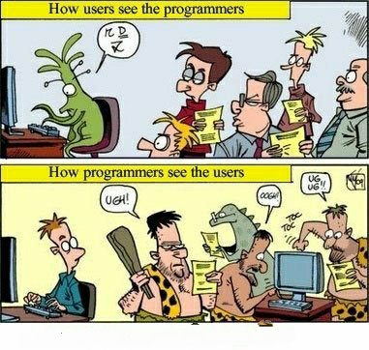
Customer Behaviour - Customer Expectations

Slide 14
Software Product
is a product designated for delivery to the user
source
codes
documents
reports
manuals
object
codes
plans
data
test results
test suites
prototypes

Slide 15
Boehm’s
Top Ten
Industrial Software Metrics

Slide 16
Boehm’s Top Ten
Industrial Software Metrics
Finding and fixing a software problem after delivery of the product is 100 times more expensive than defect removal during requirements and early design phases.
1

Slide 17

Software Myths
(Customer Perspectives)
A general statement of objectives is sufficient to get started with the development of software. Missing/vague requirements can easily be incorporated/detailed out as they get concretized.
Application requirements can never be stable; software can be and has to be made flexible enough to allow changes to be incorporated as they happen.

Slide 18
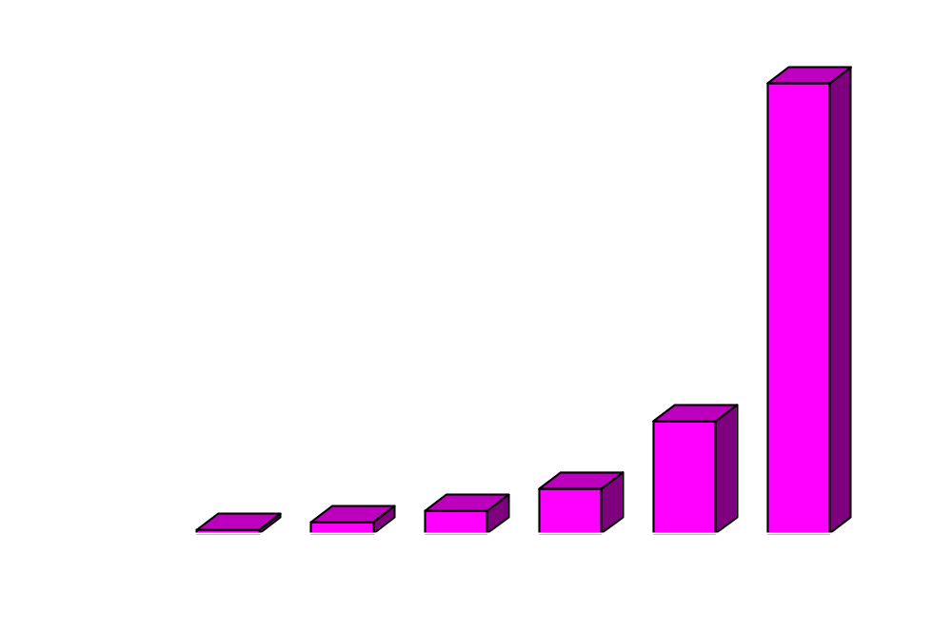
Effort to Repair Software
(when defects are detected at different stages)

Slide 19
Cumulative Effects of Error
the real problem
requirements
correct
incorrect
hidden
missing

Slide 20
Cumulative Effects of Error
requirements
correct
incorrect
hidden
missing
design
correct
incorrect
incorrect
incorrect
hidden
missing
Notes:
Correct requirements leads to correct design and incorrect requirements leads to incorrect design and finally it is cumulative.

Slide 21
Cumulative Effects of Error
design
correct
incorrect
hidden
missing
code
correct
incorrect
incorrect
hidden
missing

Slide 22
Boehm’s Top Ten
Industrial Software Metrics
Nominal software development schedules can be compressed up to 25% (by adding people, money, etc.) but no more.
2

Slide 23
Software Myths
(Management Perspectives)
When my schedule slips, what I have to do is to start a fire-fighting operation: add more software specialists, those with higher skills and longer experience - they will bring the schedule back on the rails!

Slide 24
Boehm’s Top Ten
Industrial Software Metrics
Maintenance costs twice what the development costs.
3

Slide 25
Boehm’s Top Ten
Industrial Software Metrics
Development and maintenance costs are primarily a function of the size.
4

Slide 26
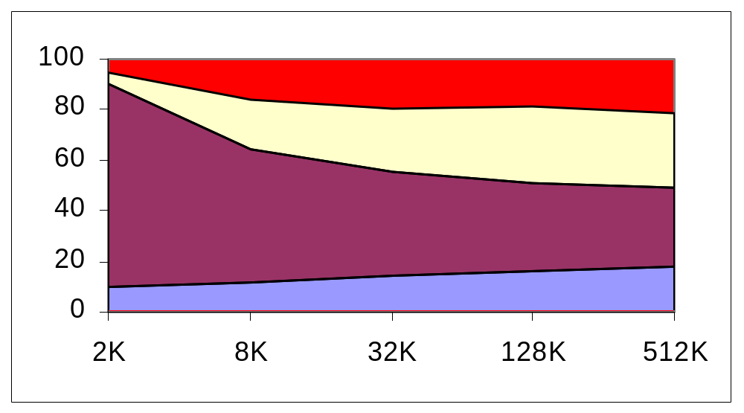
Size Vs Effort
System test
Integration
Construction
Architecture
Steve McConnell

Slide 27
Trimming is Beneficial
Removing a feature early enough saves time and effort.

Slide 28
Trim with Care!
Features added after implementation as an afterthought may cost 50 to 200 times more than the normal implementation cost!

Slide 29
Boehm’s Top Ten
Industrial Software Metrics
Variations in humans account for the greatest variations in productivity.
5

Slide 30
Software Myths
(Management Perspectives)
As long as my software engineers(!) have access to the fastest and the most sophisticated computer environments and state-of-the-art software tools, I shouldn’t be too concerned.

Slide 31
People Power
There are only three problems in developing software:
people
people
people
Gerry Weinberg

Slide 32
Boehm’s Top Ten
Industrial Software Metrics
The ratio of software to hardware costs has gone from 15:85 in 1985 and continues to grow in favour of software as the dominant cost.
6

Slide 33
Boehm’s Top Ten
Industrial Software Metrics
Only about 15% of the development effort is in coding.
7

Slide 34
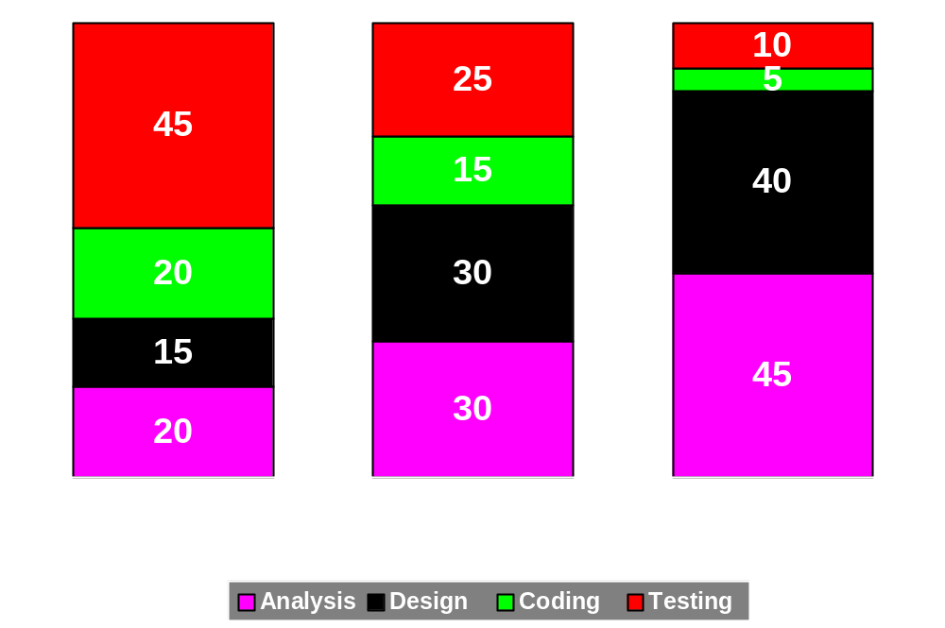
Distribution of Effort
Across Phases
Testing
Coding
Design
Analysis

Slide 35
Boehm’s Top Ten
Industrial Software Metrics
Applications products cost three times as much per instruction as individual programs; system software products cost nine times as much.
8

Slide 36
Boehm’s Top Ten
Industrial Software Metrics
9
Walkthroughs catch 60% of the errors.

Slide 37
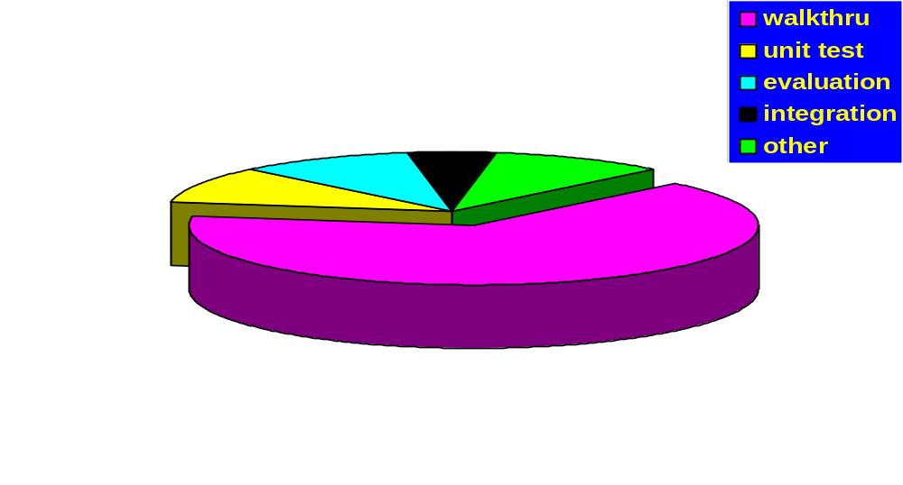
Distribution of Activities
in Defect Removal

Slide 38
Software Myths
(Developer Perspectives)
Until the software is coded and is available for testing, there is no way for assessing its quality.

Slide 39

Boehm’s Top Ten
Industrial Software Metrics
10
Many software processes obey a Pareto distribution.
20%
modules
80%
cost

Slide 40
Boehm’s Top Ten
Industrial Software Metrics
10
Many software processes obey a Pareto distribution.
20%
modules
80%
errors

Slide 41

Boehm’s Top Ten
Industrial Software Metrics
10
Many software processes obey a Pareto distribution.
80%
cost
to fix
20%
modules

Slide 42
Boehm’s Top Ten
Industrial Software Metrics
10
Many software processes obey a Pareto distribution.
20%
modules
80%
exec time

Slide 43

Boehm’s Top Ten
Industrial Software Metrics
10
Many software processes obey a Pareto distribution.
20%
tools
80%
use

Slide 44
Software Characteristics
is developed or engineered,
rarely manufactured
is custom-built; rarely assembled
is non-material,
and therefore does not wear out
is ethereal
is too flexible

Slide 45
More Pearls of Wisdom
55% of errors attributed to misunderstandings at the requirements stage!
80% of resources used in correcting these!
design errors outweigh coding errors 64% to 36%

Slide 46

Is software
Craft?

Slide 47
Are you a software craftsman?
The artist receives satisfaction from the act of creating, regardless of the ultimate usefulness of the creation.
The quality of the system is defined by elegant or complex program structures, aesthetically pleasing screen layouts and exotic (and unasked-for) system functionality.
Project deadlines are an obstacle to refining his art.

Slide 48
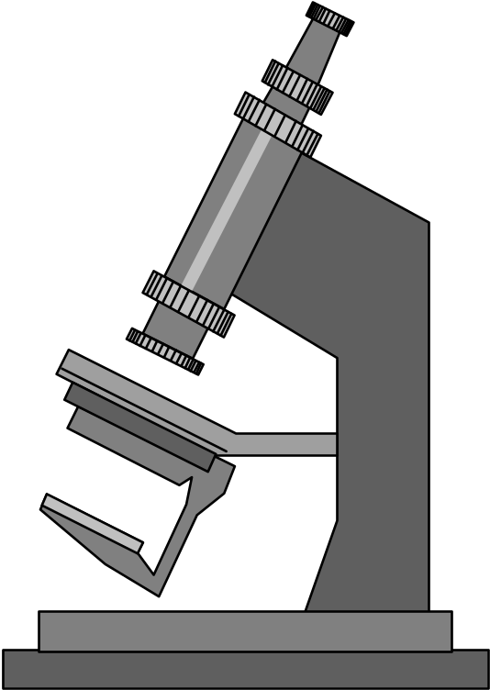
Is software
science?

Slide 49
Are you a software scientist?
The scientist receives satisfaction from discovering and understanding business truth.
The quality of analysis is defined in terms of its correctness and depth of insight into the business.
Project deadlines are important, but less so than achieving business understanding.

Slide 50
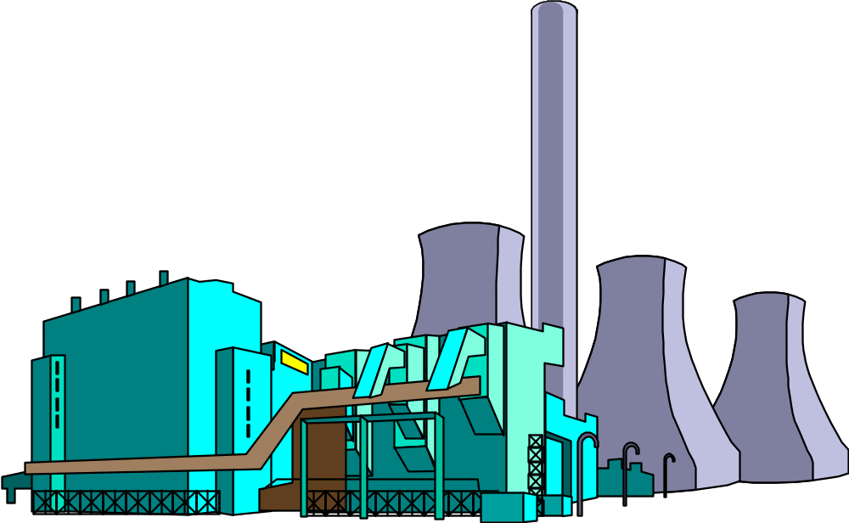
Is software
engineering?

Slide 51
Are you a software engineer?
The engineer receives satisfaction from building and delivering a system that meets performance requirements and is used by the customer.
System quality is defined in terms of system reliability, specifications met and customer satisfaction.
Project deadlines are an important measure of project success, second only to system quality.

Slide 52


Are You ………… ?
During software design I am an architect;
while designing the user interface, I am an artist;
during construction, I am a craftsman;
during unit testing.
During project management
I am an engineer!
Anonymous
quote by Steve McConnell

Slide 53
Software Process
is the process by which the user needs are translated into software requirements,
software requirements are transformed into design,
design is implemented in code,
and the code is tested, documented and certified for operational use.

Slide 54
Software Product
is a product designated for delivery to the user
is not just code
may be
  codes (source and object)
  plans
  reports
  manuals
  documents
  test suites
  prototypes
  data

Slide 55
Recap……..

Slide 56
